Slide 1
EDA + STATS PROJECT
Student name: Shaimaa Ahmed maged el Sayed Mohamed eid

Slide 2
Methodology
1. Data Collection and Preparation
Merged three separate CSV datasets containing energy consumption data using (pandas.concat)
Cleaned and aligned the energy consumption dataset with a demand dataset by converting timestamps to a unified format (pd.to_datetime)
2. Data Cleaning and Preprocessing
Removed invalid or missing values to ensure the integrity of the analysis.
Merged datasets on timestamps (pd.merge_asof) to align energy consumption records with demand levels.
3. Exploratory Data Analysis (EDA)
Visualized the distribution of energy consumption using histograms.
Explored variations in energy consumption across regions using boxplots.
Analyzed temporal trends in energy consumption over the day using line plots.

Slide 3
Methodology
4. Statistical Analysis
Conducted an ANOVA test to determine if regional differences significantly impacted energy consumption.
Used Tukey’s HSD post-hoc test to identify pairwise differences between regions if the ANOVA was significant.
Evaluated the correlation between time of day and energy consumption using Pearson correlation.
5. Threshold Definition and Savings Calculation
Defined a threshold for low energy consumption using the 25th percentile.
Calculated potential cost savings under different demand levels by applying custom savings logic based on energy consumption and demand tiers.

Slide 4
Challenges and solutions
1. Challenge: Mismatched Timestamps Between Datasets
Solution: Used (pd.merge_asof) to merge datasets based on the nearest timestamp within a backward direction, ensuring alignment of energy consumption with corresponding demand data.
2. Challenge: Missing or Invalid Data
Solution: Identified and removed rows with missing or invalid datetime values to avoid errors in merging and analysis.
3. Challenge: Column Name Inconsistencies
Solution: Stripped whitespace from column names using (columns.str.strip()) to ensure consistent referencing of fields like (‘KWH/hh (per half hour))’.

Slide 5
Challenges and solutions
4. Challenge: Complex Cost Calculation Logic
Solution: Implemented a function to calculate savings (calculate_savings) by mapping demand levels to corresponding cost rates.
5. Challenge: Statistical Analysis for Multiple Groups
Solution: Used ANOVA to test for overall differences and Tukey’s HSD for detailed comparisons.

Slide 6
Pre-Modeling insights
Energy Distribution: Energy consumption data followed a skewed distribution, with a notable concentration of values around lower consumption levels.
Regional Differences: Significant differences in energy consumption across regions were observed. Some regions exhibited higher variability in consumption patterns.
Temporal Trends: Energy consumption peaked during specific hours, indicating a strong temporal dependency influenced by usage patterns.
Low Consumption Threshold: The threshold for low consumption was identified (25th percentile), highlighting a significant portion of the data with potential for energy-saving interventions.

Slide 7
Post-modelling insights
1. Statistical Findings:
ANOVA results confirmed that regional factors significantly affected energy consumption.
Post-hoc tests pinpointed specific regions with significantly different consumption patterns.
2. Correlation Analysis:
A moderate negative correlation between hour of day and energy consumption suggested that consumption decreased at non-peak hours.
3. Savings Potential:
Substantial energy and cost savings were identified when consumption was managed below the defined threshold.
High-demand periods presented significant cost-saving opportunities when consumption was reduced.
4. Processed Data:
Cleaned and aligned dataset saved for future modeling and analysis, ensuring reproducibility and better decision-making.

Slide 8
Results
1. ANOVA Results for Region Effect on Energy Consumption
The ANOVA test checks if there are statistically significant differences in energy consumption among regions (A, B, C, and D). The results are:
F-statistic: 38.834 , P-value: 4.39e-25
Since the p-value is far less than the typical significance level (0.05), we reject the null hypothesis. This means that energy consumption significantly differs among the regions.

Slide 9
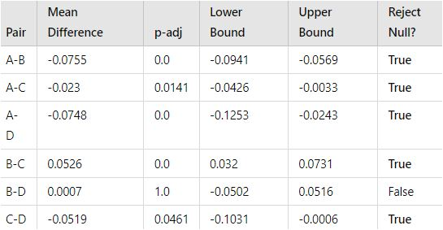
2. Post-hoc Test (Tukey HSD):
The Tukey post-hoc test further examines pairwise differences between regions to identify which regions differ significantly.
Regions A and B, A and C, and A and D have statistically significant differences.
Regions B and D do not show a significant difference.
This indicates that energy consumption in Region A is consistently lower compared to the others, while differences between B and D are not statistically meaningful.

Slide 10
3. Correlation Between Hour of Day and Energy Consumption:
The Pearson correlation test was conducted to check if energy consumption correlates with the hour of the day. The results are:
Correlation coefficient: 0.0196
P-value: 1.01e-47
While the p-value indicates the result is statistically significant, the correlation coefficient is extremely small (close to 0). This means that there is no strong linear relationship between the hour of the day and energy consumption.
4. Boxplot of Energy Consumption by Region:
The boxplot highlights the distribution of energy consumption across the four regions:
Regions A and C show higher variability with a few outliers in their energy consumption data.
Region D has the lowest energy consumption with very little variation.
Regions B and C have similar ranges of consumption.

Slide 11
Energy Consumption by Time of Day
Graph Title: The title indicates that the graph represents the energy consumption across different times of the day for various regions (A, B, C, D).
X-axis (Hour of Day): This axis represents the time of day in hours (0 to 24).
Y-axis (Energy Consumption in kWh): This axis measures the energy consumption in kilowatt-hours (kWh).
Lines for Regions: Each line represents a different region's energy consumption over the hours of the day, with legends indicating which color corresponds to which region.
Trends: The graph shows fluctuations in energy consumption throughout the day, with peaks and troughs that indicate when energy consumption is higher or lower for each region.
-> image next page

Slide 12
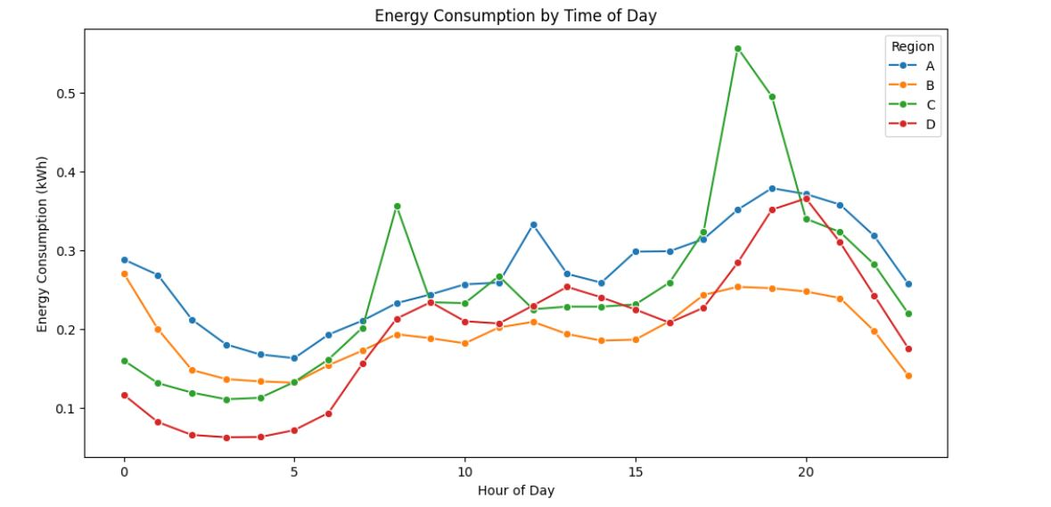

Slide 13
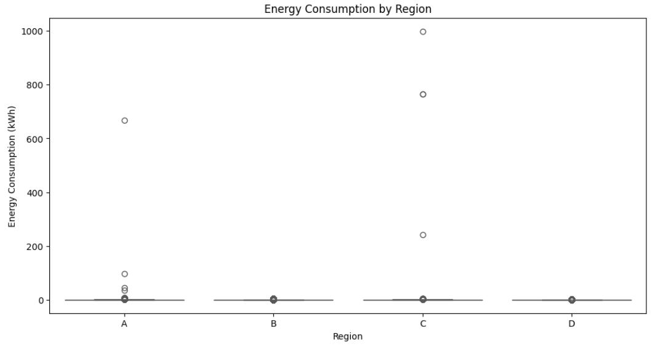
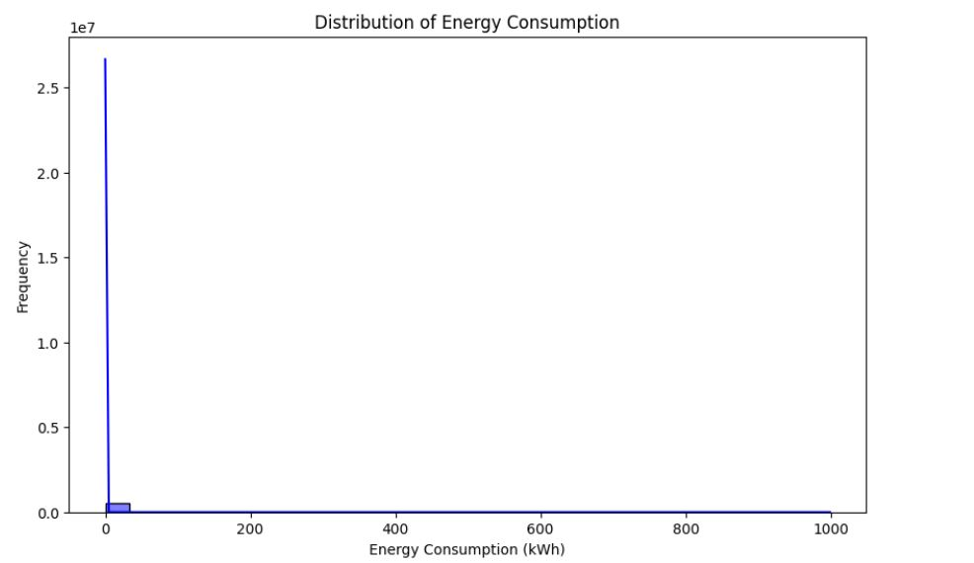

Slide 14
